Slide 1

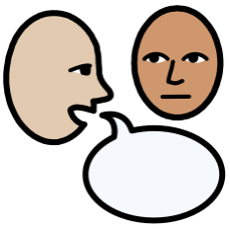
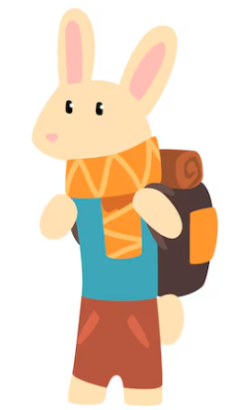



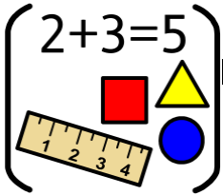



Personal Social Emotional Development:
In PSED, we will be exploring what makes each of us ‘super’
and identifying our unique strengths.
We will also think about how we can grow and improve to be the best version of ourselves.
As part of this, we will introduce the ‘Zones of Regulation’ to help children understand their emotions and learn strategies to manage how they feel in different situations.
Falconhurst School Spring 1
2026
Year Group: Reception
Communication and Language
In C+L, we will be encouraging the children to talk in full
sentences by scaffolding and modelling.
We will be introducing new ambitious vocabulary linked to topic of superheroes and people who help us.
What you can do to help at home:
- Encourage your child to talk about things they like.
- Support your child to reply in sentences
Physical Development
Children will develop basic gymnastic skills through the topic of 'traditional tales’, explore creating shapes and balances, jumps and rolls. They begin to develop an awareness of space and how to use it safely. We will also be taking part in dough gym and squiggle whilst you wiggle each day. This is to build are strength for writing.
What you can do to help at home:
-Stay active; go on walks, have a dance trying different ways of moving and balancing.
:
Literacy
In Literacy, we will be diving into the exciting world of superheroes through stories like Juniper Jupiter and Supertato. Using Juniper Jupiter, the children will practice planning and saying sentences accurately, and representing parts of the story with drawings or words. Later, we will enjoy Supertato and use it to inspire the creation of our own posters to help ‘find the Evil Pea’
What you can do to help at home:
While you’re out and about, look for posters. Ask your child what they think the poster is looking for and discuss the key information included
Maths
In Maths this term, we will continue our work on subitising. We will use nursery rhymes to help children learn the composition of numbers to 5, for example, understanding that 2 and 3 make 5, or that 1 and 4 make 5. We will finish off with exploring 2D shapes.
What you can do to help at home:
Looking out for numbers on walks, in the shops or at home.
Listen to 5 speckled frogs, 5 little men in a flying saucer.
Understanding the World
In UW we are going to be looking at the topic of special places.The children will think about places that are special to them and learn about important places in our community. We will also discuss why churches are special to many Christian people and why mosques are special to many Muslim people.
We will be learning about how things work, especially forces. Children will also learn about animals, how they are the same and different, and the different ways they can be sorted.
Expressive Arts and Design
In EAD, the children will explore music and
storytelling through percussion instruments. They
will experiment with creating sounds to represent different animals' movements and noises, and work together to develop a sound story.
The children will have the opportunity to taste a variety of fruits, share their thoughts about what they like and don’t like. At the end of this topic the children will create their own delicious fruit kebabs!

