Slide 1
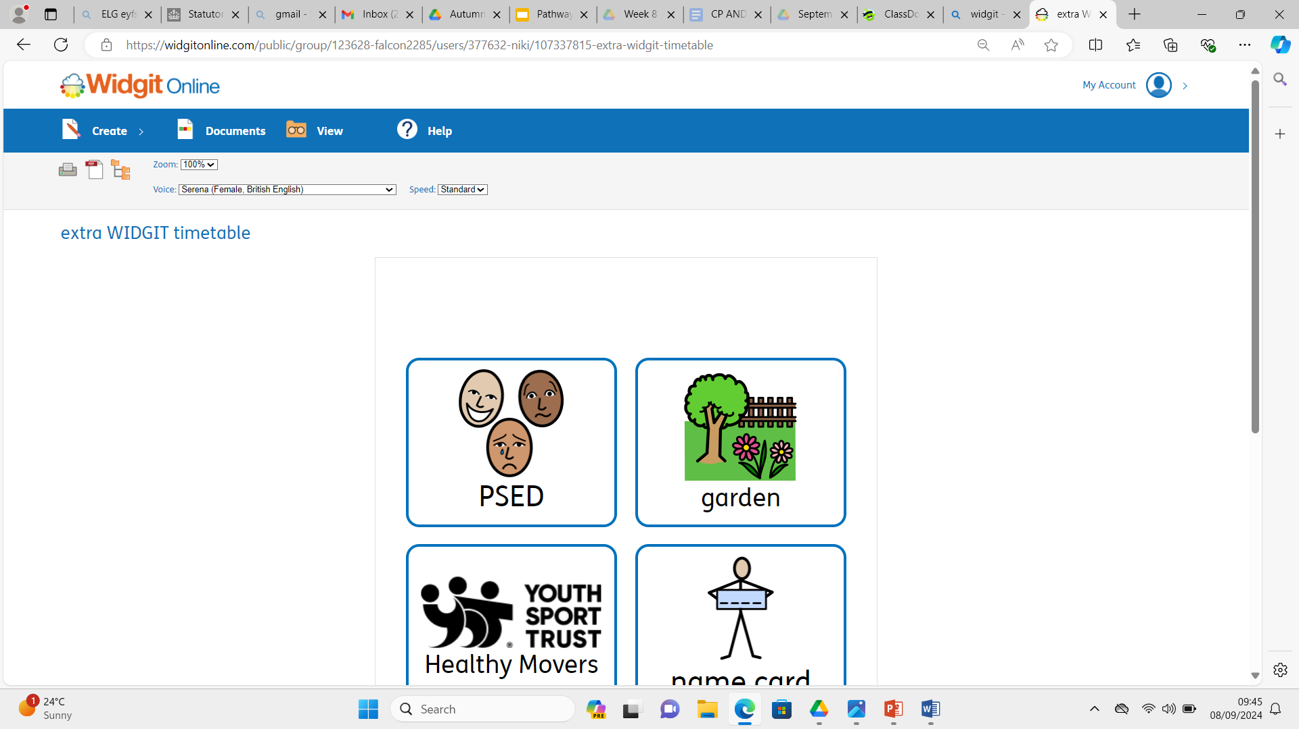
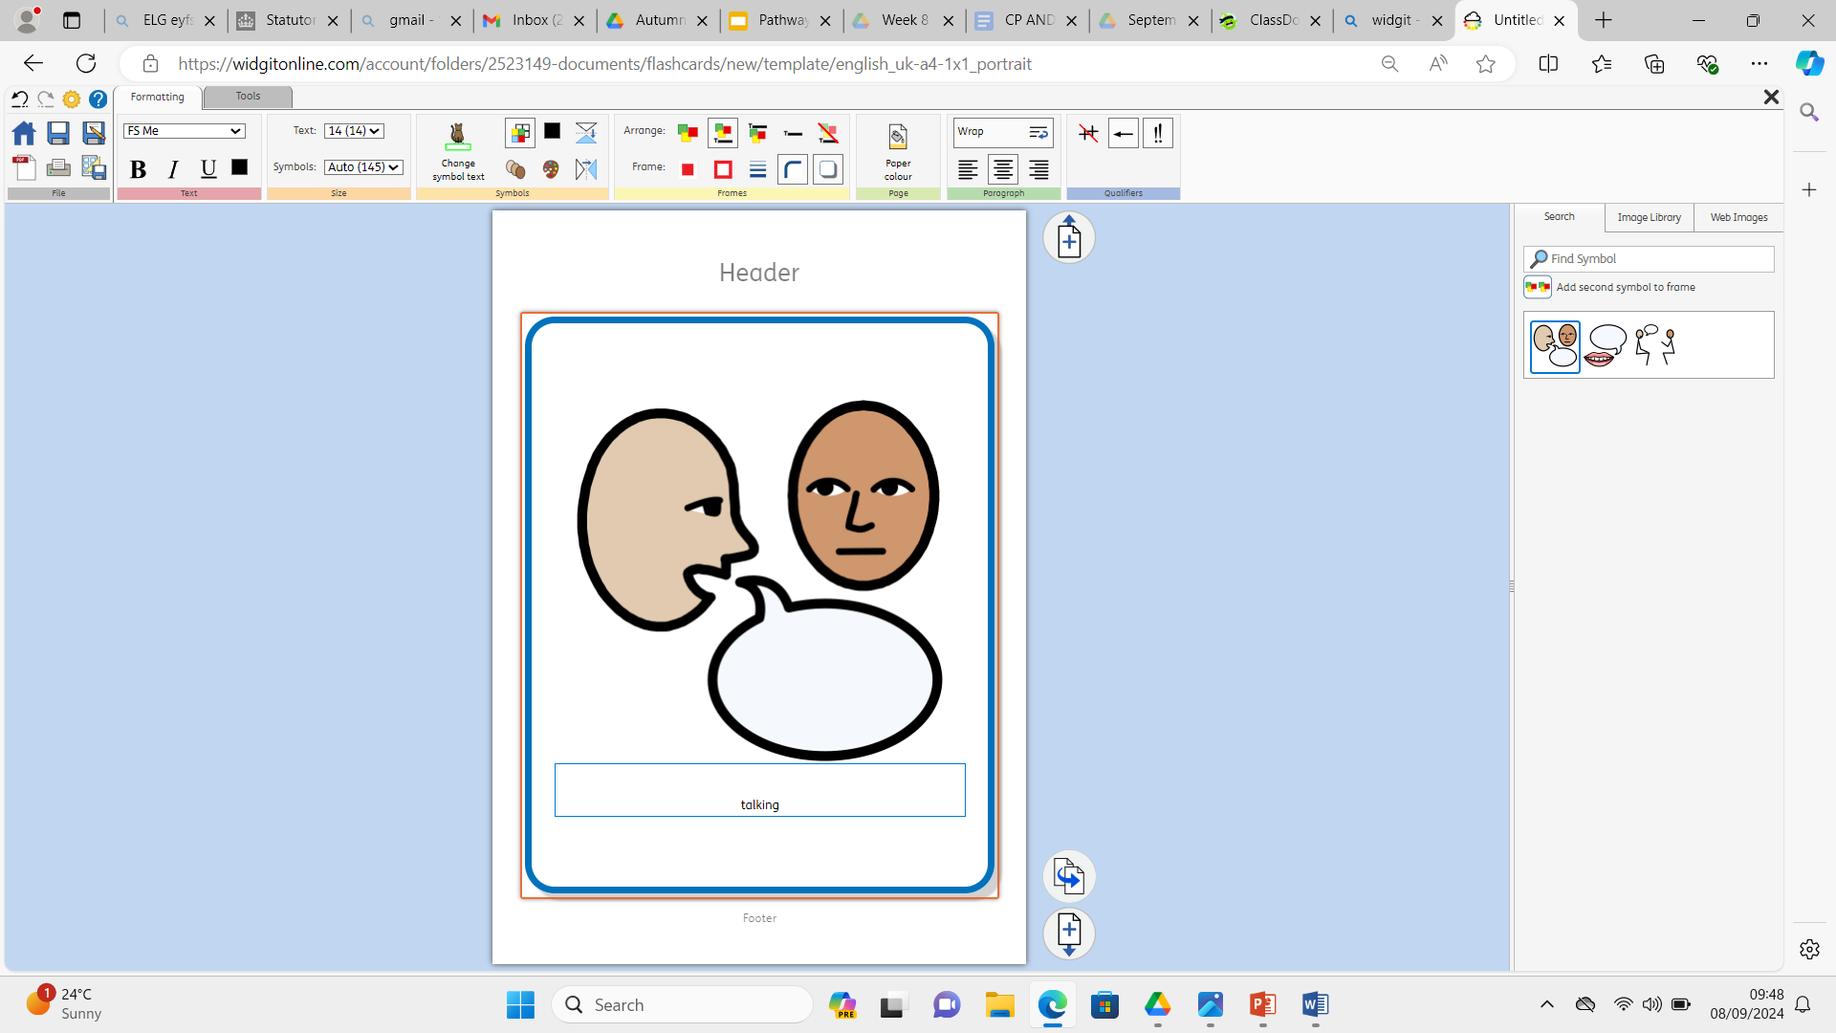
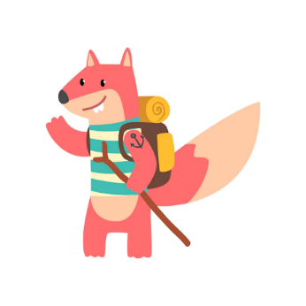



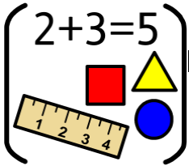






Personal Social Emotional Development:
In PSED we will be talking about lifecycles. We will also be encouraging the children to do more things independently.
What you can do to help at home:
-Share stories such as the Hungry Caterpillar showing life cycles
-Grow some seeds at home.
-Make sure that your child can manage their self-help skills such as getting dressed, managing their toileting needs, trying new foods and remembering where they have put their toys and items for school.
Falconhurst School
Summer 1 2026
Year Group: Nursery
Communication and Language
In CL we will focus on talking in a simple sentence to adults and other children in the setting. We will encourage your child to use some of the recently introduced vocabulary that they are learning in school when talking.
What you can do to help at home:
-Talk to your child all the time about what they see, what they are doing and how they are feeling. This will help them build their vocabulary. Model how to respond in a sentence if your child answers in single words.
Physical Development
In PD we will continue to use the skills we have learnt when playing games. We will be developing our throwing, catching and aiming skills. What you can do to help at home:
Use a soft ball or rolled up socks to practice throwing, catching and aiming.
Going to the playground and trying the different activities will all help to develop the children’s balance, stability and confidence.
Playdough, drawing and colouring will all help develop pencil grip and control to help your child when forming letters.
:
Literacy
In Literacy we are going to be reading Jasper’s Beanstalk and The Hungry Caterpillar. The children will be encouraged to talk about each story and join in with repeated phrases. They will be also be encouraged to make marks to retell the story.
What you can do to help at home:
Share stories together. Talk to your child about; Who is in the story? What happened in the story? What did you enjoy? Why?
Watch the recordings that we will send of our stories.
Maths
In maths we will be learning to notice, continue and make our own patterns. We will be using shapes to build models and will be learning to describe their features and to name different shapes.
What you can do to help at home:
-Go on a shape hunt. What shapes can you see?
-Make patterns such using different objects such as red and blue blocks or forks and spoons.
Understanding the World :
In UW we will be planting seeds and learning what we
need to do to help them grow. We will also be learning
about lifecycles of different animals and humans.
What you can do to help at home:
-Look at pictures of the children when they were younger
talk about how they have changed. Look at pictures of
other family members and talk about how they have changed.
-Please send in pictures of your children as babies so
we can talk about how they have changed.
Expressive Arts and Design:
In EAD we will be learning how to thread and weave in different contexts. We will also continue to develop our
mark making skills and crafting skills.
What you can do to help at home:
-Encourage your child to do some of the following activities regularly to build their fine motor skills; playdough, help ball up socks, peel oranges/bananas, play with poppets, make pasta necklaces, peg up laundry, post coins into piggy banks, practise using scissors, draw pictures.

