Slide 1
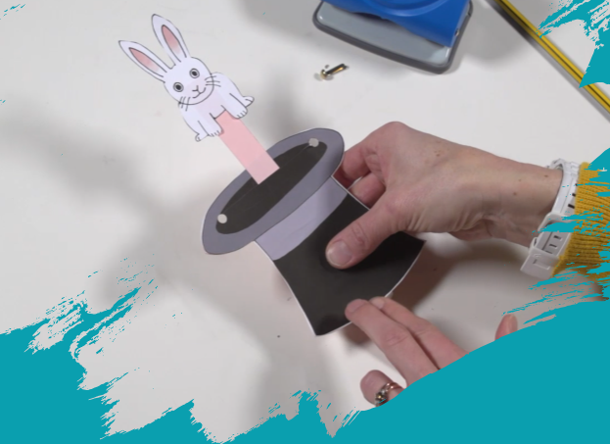
English
In English, we will be reading the book ‘Nibbles the Book Monster’ to help us write a diary entry in the first person based on his adventures.
What you can do to help at home:
Listen to your child reading their school book as often as possible
Read to your child a book they may not be able to read independently for pleasure.
Autumn 2 2024
Years 1 & 2
Geography
In geography we will be learning about weather and different types of weather such as a heatwave, drought, flood, monsoon, blizzard. We will also be learning about the location of the United Kingdom and the physical and human features found within England.
What you can do to help at home:
Look at different maps together of United Kingdom. Talk about what you can see: rivers, mountains, cities and towns. Find the capital, London,
Maths
In maths Year One children we will be learning about 2D shapes and 3D shapes. We shall be learning to recognise and name the 3D shapes, sphere, cone, cuboid, pyramid, cylinder and cube and the 2D shapes, square, rectangle, circle and triangle.
What you can do to help at home:
Go in a shape hunt at home. What objects or packaging can you find in these shapes?
In maths Year Two children we will be learning how to add and subtract 2-digit numbers Then we will move on to shape where we will learn the names of 2D and 3D shapes and be able to describe their features, such as edges and vertices.
What you can do to help at home:
- Log on to Numbots at home to help increase fluency.
Science
In science we will be learning about humans. This will include how humans take care of themselves thinking about hygiene, food, exercise and teeth.
We shall also be learning about plants and what they need to grow.
What you can do to help at home:
Create a weekly menu and exercise programme for someone your age.
Plant some cress seeds. Put one pot in the light and one in the dark. Record what happens. Do they grow the same?
Design Technology
In DT will be learning about using slider mechanisms to make a moving book.
PHSE
In PHSE we will be learning about valuing and respecting differences and how we can act against bullying
.
Religious Studies
In RE will be learning about the creation of the world.
Physical Education
In PE we will be learning about fundamental movements and net and wall games.
Music
In music we will be learning about the beat at timbre in music and use tuned and untuned percussion.
Computing
In computing we will be learning about animation and how to make our own moving images.

