Slide 1
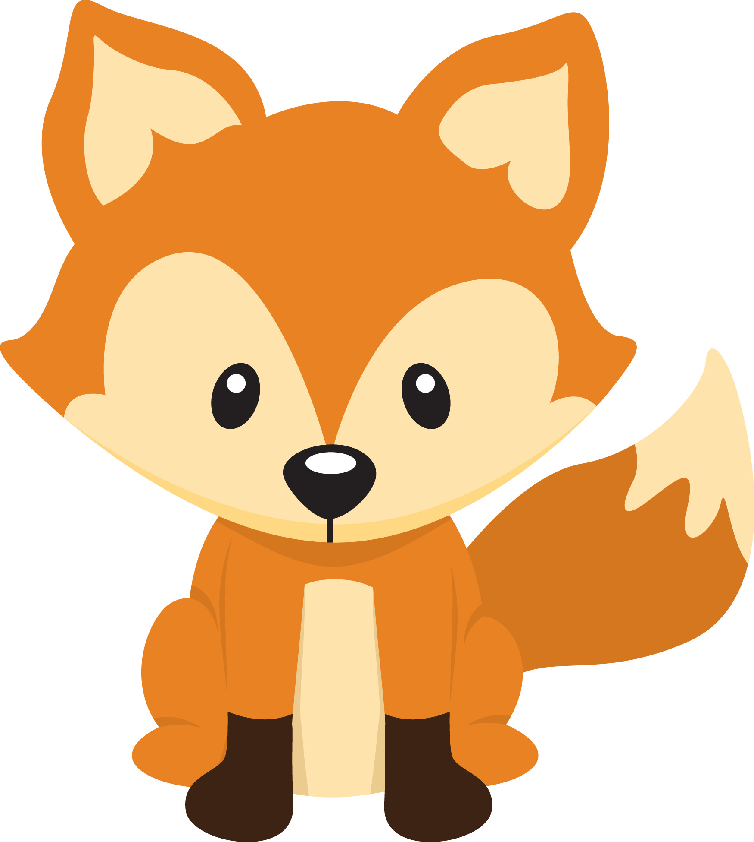
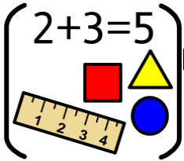
Personal Social Emotional Development:
In PSED we will be getting to know our new classmates. We will also be thinking about special people in our lives and different emotions we can feel. We will be supporting the children to share and take turns.
What you can do to help at home:
-Play turn taking games and games involving sharing together.
Encourage your children to try and do things independently such as putting their toys away, putting on their coats on and zipping them up.
Falconhurst School Autumn 1 2024
Year Group: Nursery
Communication and Language
In CL we will focus on building our confidence to talk to adults and other children in the setting. We will encourage your child to talk about themselves and what they like to do in sentences.
What you can do to help at home:
-Encourage your child to talk about things they like.
- Practise taking turns when talking.
- Support your child to reply in sentences
Physical Development
In PD we will be developing our climbing, throwing, moving and balancing skills in our outdoor area. We will also be working on holding small tools correctly such as pens and scissors.
What you can do to help at home:
Play throwing and catching games together.
Practise holding a pencil correctly.
Go outside each day, going for a walk or visiting the playgrounds
:
Literacy
In Literacy we are going to be reading Goldilocks and the Three Bears and A Bit Lost. The children will be encouraged to talk about each story and join in with repeated phrases. They will be also be encouraged to make marks to to retell the story,
What you can do to help at home:
Share stories together. Talk to your child about; who is in the story? what happened in the story? What did you enjoy? Why?
Watch the recordings that we will send of the story.
Maths
In maths we will be singing lots of songs that involve counting. We will focus on saying the numbers 1-5, counting objects and talking about the value of each number.
What you can do to help at home:
- Sing counting songs together e.g. Five little ducks
- Look out for numbers in the environment e.g. What number is on that front door?
Understanding the World :
In UW we will be thinking about families and
encouraging the children to talk about their family.
We will also be thinking about our bodies, our local
area and celebrations such as Harvest Festival.
What you can do to help at home:
-Encourage your child to talk about who is in your
family and what you like to do together.
- Send in a family photo for us to have on the wall
Expressive Arts and Design:
In EAD we will be learning how to draw self portrait
and use different resources including glue, water
colours, paint and playdough to create artwork.
What you can do to help at home:
Learn the names of different colours
- Talk to the children about what they are building and
creating at home

