Slide 1
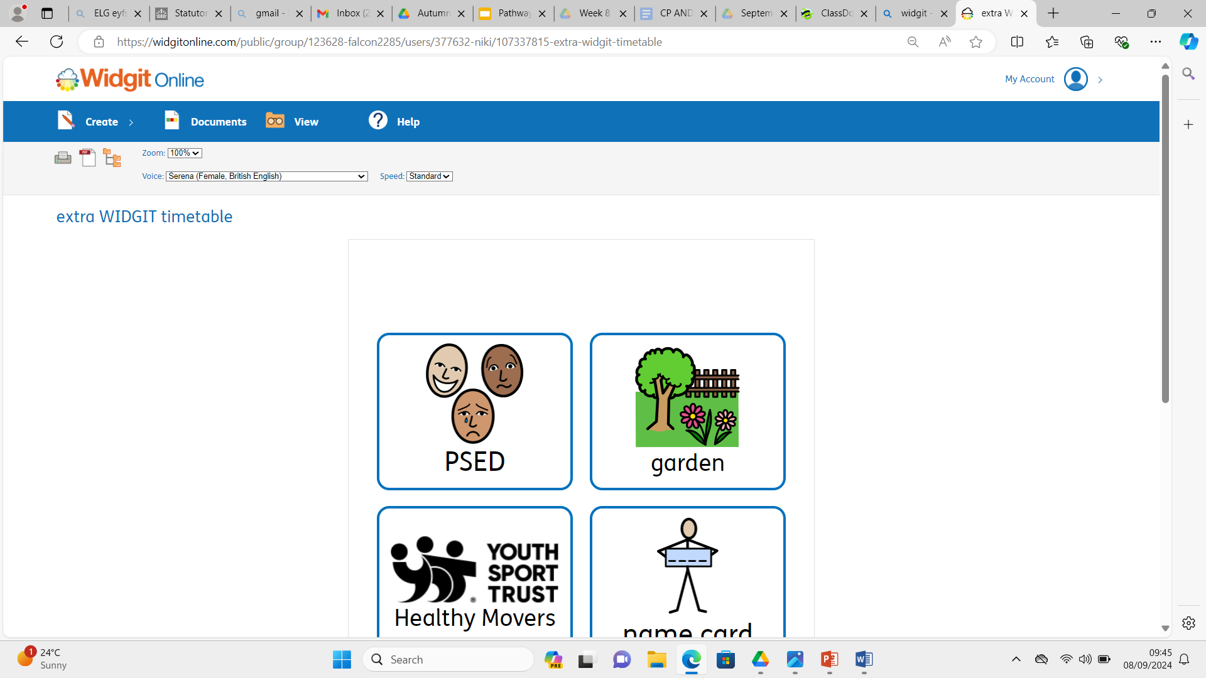
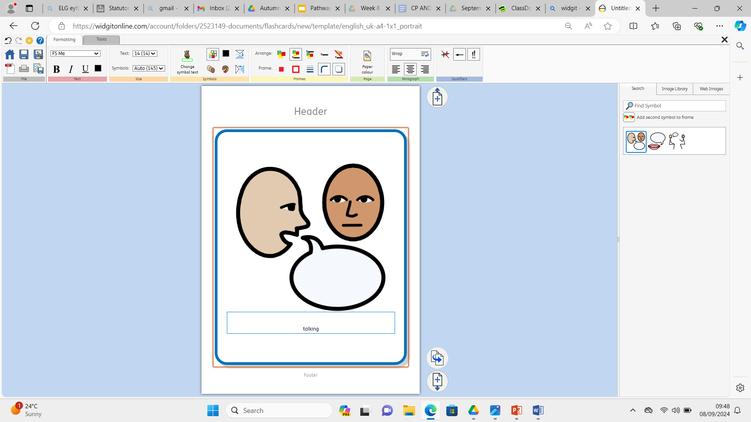
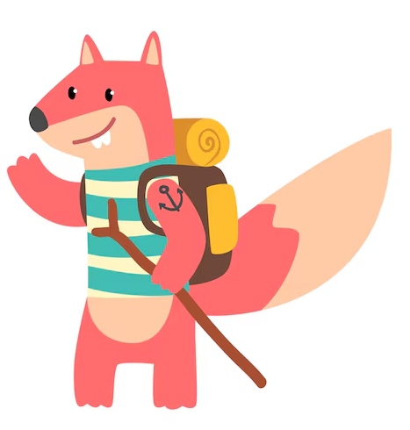



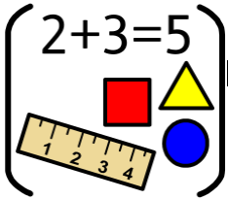





Personal Social Emotional Development:
In PSED we will be talking about all the ways that we are all different and special. We will be thinking about how it is okay to be different and like different things. We will also be celebrating all of our talents.!
What you can do to help at home:
-Talk to your child about all the things that they are good at
-Encourage your children to try and do things independently such as putting their toys away, putting on their coats on and zipping them up.
Falconhurst School Autumn 2 2025
Year Group: Nursery
Communication and Language
In CL we will focus on talking in a simple sentence to adults and other children in the setting. We will encourage your child to use some of the recently introduced vocabulary that they are learning in school when talking.
What you can do to help at home:
-Encourage your child to talk about things they like.
- Practise making eye contact and taking turns when talking.
- Support your child to reply in sentences.
Physical Development
In PD we will be developing our climbing, throwing, moving and balancing skills in our outdoor area. We will also be working on holding small tools correctly such as pens and scissors.
What you can do to help at home:
Play throwing and catching games together.
Practise holding a pencil correctly.
Go outside each day, going for a walk or visiting the playgrounds.
:
Literacy
In Literacy we are going to be reading The Gingerbread man.
The children will be encouraged to talk about our story and join in with repeated phrases. They will be also be encouraged to make marks to retell the story,
What you can do to help at home:
Share stories together. Talk to your child about; who is in the story? what happened in the story? What did you enjoy? Why?
Watch the recordings that we will send of the story.
Maths
In maths we will be singing lots of songs that involve counting. We will be learning to notice groups of numbers without counting them and to begin to identify patterns.
What you can do to help at home:
- Sing counting songs together e.g. Five little ducks
-Look for patterns when you are out and about or at home.
- Practise counting during everyday activities e.g. walking up/down steps.
Understanding the World :
In UW we will be thinking about celebrations such as Harvest birthdays, Diwali and Christmas. We will be thinking
about some of the ways these special times are
celebrated.
What you can do to help at home:
-Encourage your child to talk about the special times
they celebrate and share pictures with them of past
celebrations that they may not remember.
-Please send in pictures of any special times that your family celebrates at home.
Expressive Arts and Design:
In EAD we will be using different methods to apply
paint and continue to develop our sticking skills. We
will start to develop our scissor grip and look at the work of the artist Kandinsky.
What you can do to help at home:
Learn the names of different colours.
Encourage creating and building at home.
Talk about what they are building and creating at home.

