Slide 1
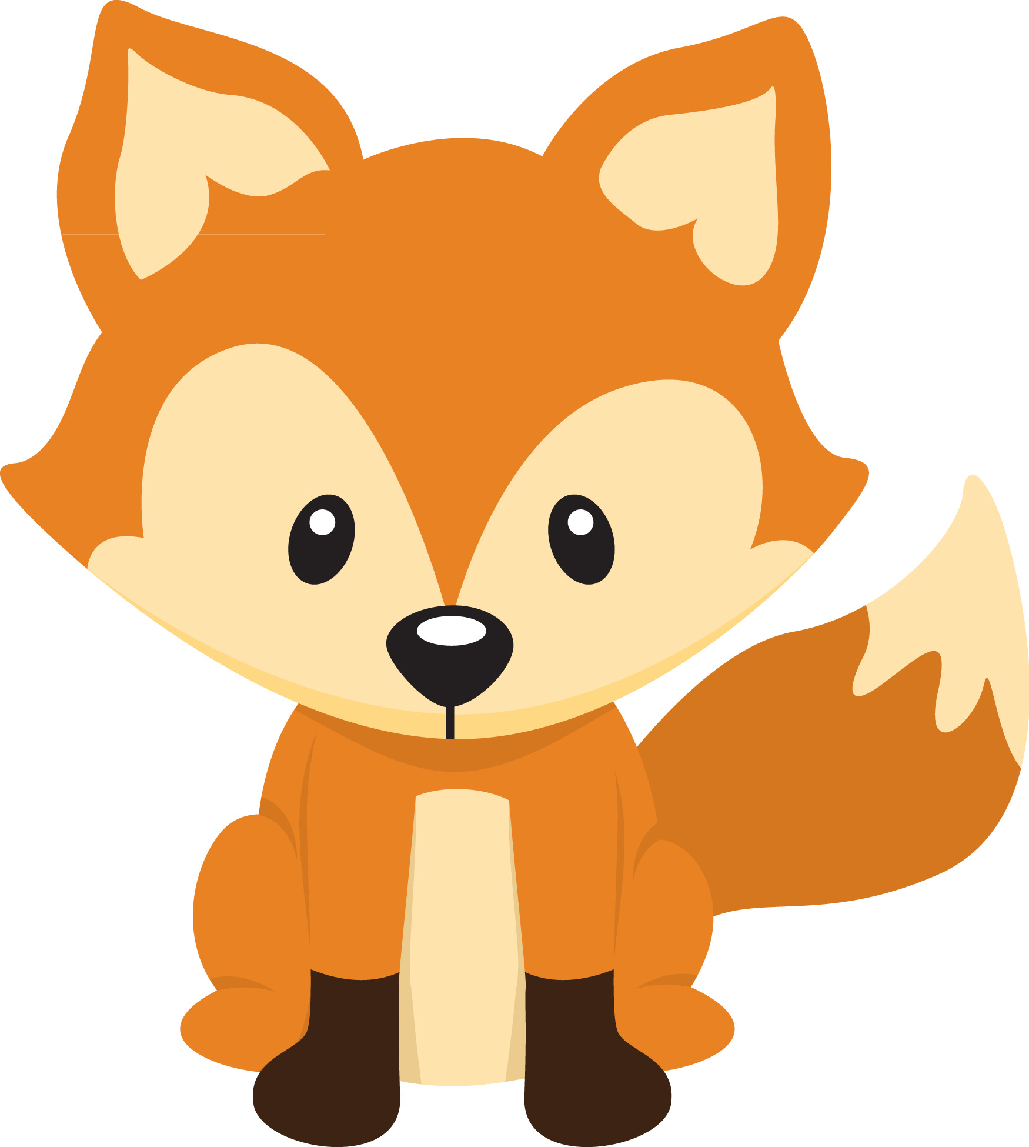
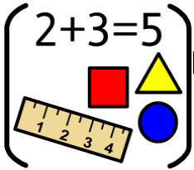
Personal Social Emotional Development:
In PSED we will be talking about the different people who keep us safe when we are at home and when we are at school. We will be learning about road safety and what we can do to keep our bodies safe. We will also be talking about ways that we can help with our emotions.
What you can do to help at home:
-Remind your child about road safety when you are by a road
- Help your child recognise emotions they are feeling e.g. I think you are sad and talk about what they can do to cope with that feeling.
Falconhurst School
Spring 1 2025
Year Group: Nursery
Communication and Language
In CL we will focus on talking in a simple sentence to adults and other children in the setting. We will encourage your child to use some of the recently introduced vocabulary that they are learning in school when talking.
What you can do to help at home:
-Encourage your child to use full sentences when talking and replying.
- Practise taking turns when talking.
- Talk about the meaning of unknown words or topic words on ClassDojo.
Physical Development
In PD we will continue to develop a range of skills including climbing, throwing, jumping and moving in different ways. We will be taking part in activities to develop our muscles ready for making marks.
What you can do to help at home:
Go for a walk and play at the park. Encourage your child to try a wide range of play equipment.
Get Active at home BBC Tiny Happy People have a range of activities that you can do at home
:
Literacy
In Literacy we are going to be reading The Journey Home from Grandpa’s and Come on Daisy. The children will be encouraged to talk about each story and join in with repeated phrases. They will be also be encouraged to make marks to retell the story.
What you can do to help at home:
-Share stories together. Talk to your child about; Who is in the story?
-What happened in the story? What did you enjoy? Why?
-Watch the recordings that we will send each week of our stories.
-Join the library so you can share a book everyday
Maths
In maths we will be singing lots of songs that involve counting. We will finding different ways to represent 1, 2 and 3, making our own patterns, continuing to learn and use positional vocabulary.
What you can do to help at home:
- Sing counting songs together e.g. Five little ducks
-Spotting numbers when you are out and about.
- Use everyday objects e.g. tin cans to make sets of 1, 2 and 3 objects.
Understanding the World :
In UW we will be thinking about different jobs that people do. We will learn about the skills people need to do different jobs. We will learn about floating and sinking and what happens when water freezes and melts.
What you can do to help at home:
-Talk to your child about the jobs that you do.
-Explore floating and sinking at bath times
-Freeze some ice cubes and talk about what happens
when water melts and freezes.
Expressive Arts and Design:
In EAD we will have a big focus on junk modelling. The children will have opportunities to practise cutting out different materials and explore ways of joining them to see what they can create.
What you can do to help at home:
Practise holding and using scissors
- Show your child different junk items e.g. toilet roll tube and discuss what they are made of. Encourage them to tell you what they could turn it into and how they might try that.

