Slide 1
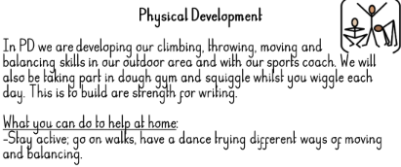
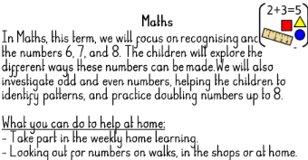
Falconhurst School Autumn 1 2024
Year Group:
:

