Slide 1
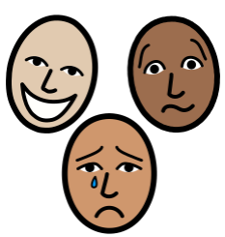
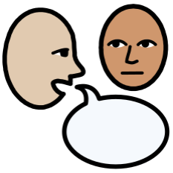
Personal Social Emotional Development:
In PSED we will be getting to know our new classmates and
teachers.. We will be understanding our feelings and how we
can effect others. We will continuing to develop sharing and turn taking.
What you can do to help at home:
-play turn taking games and games involving sharing together.
-continue to help support your child to be independent. This can be done by tidying own toys away, getting dressed by themselves.
Falconhurst School Autumn 1 2024
Year Group: Reception
Communication and Language
In C+L we are are focusing on talking to adults and our
classmates in sentences. Building confidence to talk about themselves and when to ask for help.
What you can do to help at home:
- Encourage your child to talk about things they like.
- Support your child to reply in sentences
Physical Development
In PD we are developing our climbing, throwing, moving and
balancing skills in our outdoor area. We will also be working on holding small tools correctly such as pens and scissors.
What you can do to help at home:
-moving in different ways (skipping, jumping, balancing).
-practice holding a pencil correctly.
-go for a walk and play at the park, using different playground equipment
:
Literacy
In Literacy we are going to be reading The Something by
Rebecca Cobb. The children will be encouraged to talk about the story and predict what might happen next. We will be encouraged to make marks to predict what might happen in the story.
What you can do to help at home:
Share stories together. Talk to your child about; who is in the story? what happened in the story? What did you enjoy?
Maths
In Maths we will be sorting and group colours, shapes, size and patterns. We will then be recognising and sorting numbers 1-3. We will be counting up to 10 and joining in with lots of songs that involve counting.
What you can do to help at home:
- Sing counting songs together e.g. Fish Alive, One Big Hippo.
- Look out for numbers in the environment.
Understanding the World
In UW we are going to be looking at the topic all about me. This will focus on our bodies, feelings, families, school and local area. We will discuss different celebrations that are special to us such as birthdays. As it comes to the end of this half term we will start to focus on Autumn and how the season is changing.
Expressive Arts and Design
In EAD we will be learning how to create a self
portrait. We will be looking into mirrors and observing our own faces to create these. For the self portraits we will use different resources including glue, water colours, paint and playdough to make the artwork.

