Slide 1
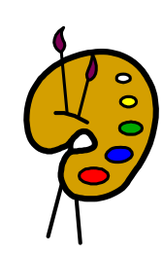
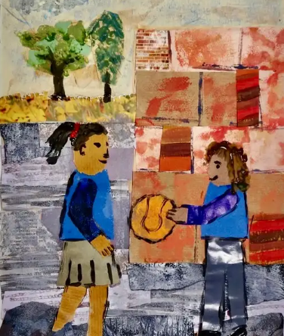
English
In English, we will be reading the book ‘The Lion Inside’ to help us write our own story based around two different animals, one scared and one brave.
What you can do to help at home:
Listen to your child reading their school book as often as possible
Read to your child a book they may not be able to read independently for pleasure.
Spring 1 2025
Years 1 & 2
History
In history we will be learning about significant people from history. We will focus on Florence Nightingale and Mary Seacole, both whom were nurses and dedicated their lives to caring for the sick and injured. Both women changed and influenced the future of nursing.
What you can do to help at home:
Discuss what a nurse does
Talk about how medicine and care was different from when you were young to now.
Research Florence Nightingale and Mary Seacole
Maths
In maths Year One children will be learning about place value with numbers up to 20. We shall be finding one more and one less of numbers, comparing them using the compare symbols. We shall be doing addition and subtraction with numbers up to 20 and finding doubles and related facts.
What you can do to help at home:
Practice counting forwards and backwards to 20 and writing the numbers with the correct formation.
Log on to Numbots at home to help increase fluency.
In maths Year Two children will be learning to count money using coins and notes. They will calculate total amounts and find the change.
Children will learn about multiplication and division by making the connection between repeated addition and multiplication. They will make this connection by recognising equal and unequal groups.
What you can do to help at home:
- Log on to Numbots at home to help increase fluency.
Science
In science we will be learning about materials. This will include exploring different materials such as wood, plastic, glass, metal and rocks.
We shall also be revisiting our plants investigation and see how the plants have grown in the light and dark.
What you can do to help at home:
Look at different objects around home. Can you group them into different materials?
Choose some objects and see if they float or sink in the water?
Art
In Art will be learning about life in colour. Children will learn about primary and secondary colours, colour mixing and using different tools
PHSE
In PHSE we will be learning and thinking about keeping safe.
Religious Studies
In RE will be learning about why we should care for the world.
Physical Education
In PE we will be learning about gymnastics and fielding games.
Music
In music we will be learning
about the Beat, ostinato, pitched/unpitched and patterns in music. We will use untuned percussion.
Computing
In computing we will be learning about typing skills, data handling and e-books

