Slide 1
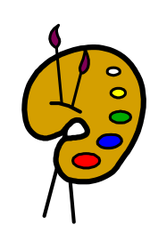
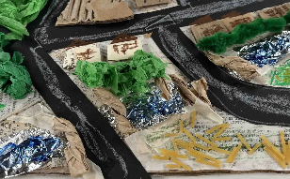
English
In English, we will be reading the book ‘Toys in Space’ to help us write our own story based on lost toys.
What you can do to help at home:
Listen to your child reading their school book as often as possible
Read to your child a book they may not be able to read independently for pleasure.
Summer 1 2025
Years 1 & 2
History
In history we will be learning about The Great Fire of London. Children will learn about the main events of this historical event and learn about the artefacts that we use as historians to find out about the past.
What you can do to help at home:
Research The Great Fire Of London
Look at pictures of how London has changed over the last 400 years
Think about how fires spread. What do we do if there is a fire.
Maths
In maths Year One children will be learning about multiplication and division and fractions. We shall be learning to count in 2s,5s and 10s, arrays, grouping and sharing. In fractions we shall learn about finding halves and quarters of different shapes and amounts.
What you can do to help at home:
Practice counting forwards and backwards to 100 and writing the numbers with the correct formation.
Log on to Numbots at home to help increase fluency.
In maths Year Two children will be learning about fractions, learning to recognise ½, ¼ and 1/3. Children will also be revisiting time and learning to tell the time to o’clock, half past, quarter to and quarter past.
What you can do to help at home:
Log on to Numbots at home to help increase fluency.
Log on to Times Tables Rock Stars
Ask children to tell the time at different points of the day.
Science
In science we will be learning about living things and their habitats. We shall be looking at different habitats such as our local area, polar, ocean, woodland, and desert. We shall learn about why certain animals live in these types of habitats and why.
What you can do to help at home:
Do some research in to what animals live in these types of habitats.
Choose an animal and find out where it lives, what kind of habitat it lives in and what food it eats.
Art
In Art will be generating ideas from a wider range of stimuli, exploring wats to use different media such as relief pictures (3D qualities). We will be using maps as our inspiration,
PHSE
In PHSE we will be learning about being my best.
Religious Studies
In RE will be learning about how we know some people have a special connection to God? We will learn this through the world views of Sikh, Muslim, Christian, Jewish, and Hindu.
Physical Education
In PE we will be learning about target games.
Music
In music we will be learning
about active listening, performing a movement piece and using graphic scores.
Computing
In computing we will be learning about typing skills, e safety and using programming.

