Slide 1

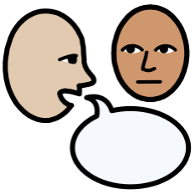
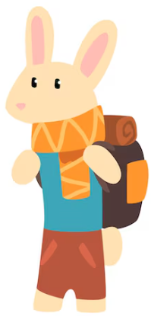
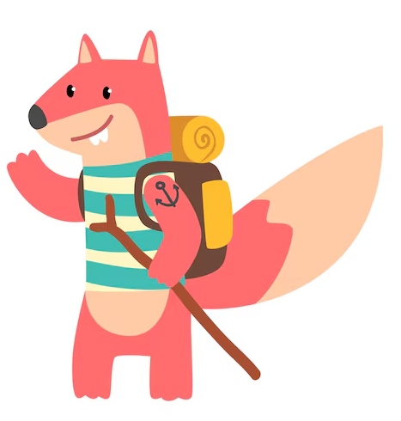



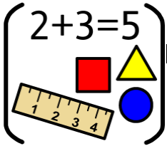



Personal Social Emotional Development:
In PSED we will be getting to know our new classmates and
teachers.. We will be understanding our feelings and how we
can effect others. We will continuing to develop sharing and turn taking.
What you can do to help at home:
-play turn taking games and games involving sharing together.
-continue to help support your child to be independent. This can be done by tidying own toys away, getting dressed by themselves, using the toilet independently, washing hands independently.
Falconhurst School Autumn 1 2025
Year Group: Early Years
Communication and Language
In C+L we are are focusing on talking to adults and our
classmates in sentences. Building confidence to talk about themselves and when to ask for help.
What you can do to help at home:
-Encourage your child to talk about things they like.
- Reinforce making eye contact with the speak and taking turns when talking.
- Support your child to reply in sentences.
Physical Development
In PD we are developing our climbing, throwing, moving and
balancing skills in our outdoor area. We will also be working on holding small tools correctly such as pens and scissors.
What you can do to help at home:
-moving in different ways (skipping, jumping, balancing).
-practice holding a pencil correctly.
-go for a walk and play at the park, using different playground equipment.
:
Literacy
In Literacy the Reception children are reading The Something and Nursery children Goldilocks. The children will be encouraged join in with repeated sentences, talk about the story and predict what might happen next. We will be making marks to show what happens in the story and predict what might happen next.
What you can do to help at home:
Share stories together. Talk to your child about; who is in the story? What happened in the story? What did you enjoy?
Maths
Reception children will be sorting and group colours, shapes, size and patterns. They will then be recognising and sorting numbers 1-3. and counting up to 10. Nursery children will be focusing on numbers to 5 and learning lots of number songs.
What you can do to help at home:
- Sing counting songs together e.g. Fish Alive, One Big Hippo.
Look out for numbers in the environment.
Count together as you go up and down steps.
Understanding the World
In UW we are going to be looking at the topic all about me, focuing on our bodies, feelings, families, school and local area. We will discuss different celebrations that are special to us such as birthdays. We will learn about Autumn and the changes we see.
What you can do to help at home:
-Talk about who is in your family and what you like to do together.
Expressive Arts and Design
In EAD we will be learning how to create a self
portrait. We will be looking into mirrors and observing our own faces to create these. We will use different resources including glue, watercolours, paint and playdough to make artwork.
What you can do to help at home:
Learn the names of different colours
- Encourage your child to draw and be creative at home.

